Slide 1
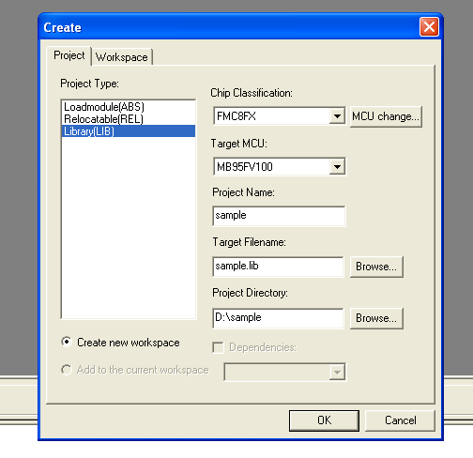
In softune, new project => select library => fill the project name, directory
Select LIB
Fill blank

Slide 2
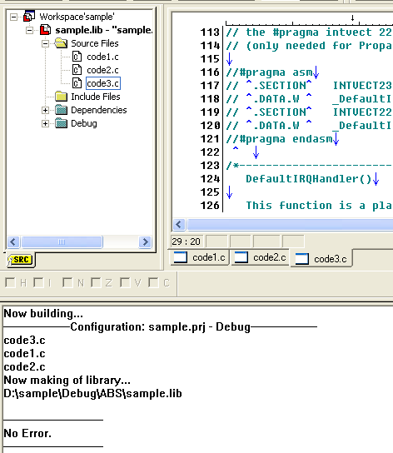
After a lib project created, add lib function source code file into project => build the project => generate a lib file in ABS folder
Lib project
Add code
Build project
Generate lib file

Slide 3
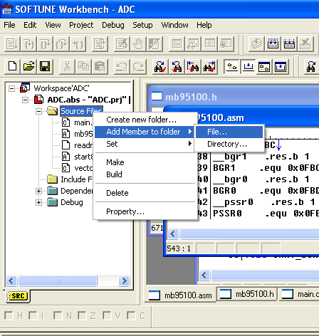
Open original project => add member to folder
Abs project
Prepare to add lib file

Slide 4
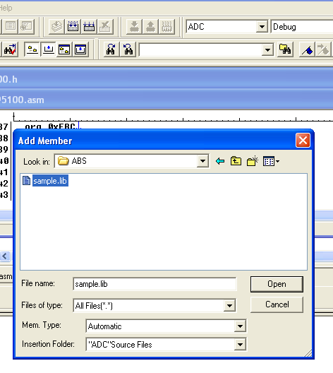
Add lib file into normal project
Find the generated lib file in lib project abs folder
Select all files

Slide 5
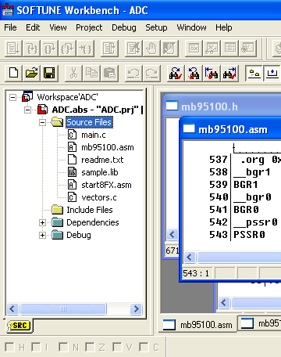
Finish lib file generation and add, the main.c in abs project can call the function in lib file.
Lib file be added

